Slide 1
Review Session 2 Flow to Wells

Slide 2
Know at least a few of these Basic Assumptions (3-5)
Aquifer bounded on the bottom
Horizontal Geologic Formations (with infinite extent)
The potentiometric surface is horizontal and is steady prior to pumping
Any changes in potentiometric surfaces are due to pumping
Aquifer is homogeneous and isotropic
All flow is radial towards the well
Groundwater flow is horizontal
Darcy’s Law is valid
Water has constant density and viscosity
Wells are fully penetrating
Pumping well has infinitesimal diameter and 100 efficiency

Slide 3
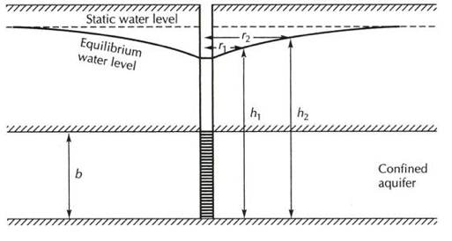
Steady State Confined Aquifer (Thiem solution)
Q is volume flow rate of well
r1 is radius from pumping well to observation well 1
r2 is radius from pumping well to observation well 2
h1 is head at well 1
h2 is head at well 2
Know how to translate depth to water information into head differences
i.e. h2-h1=d1-d2

Slide 4
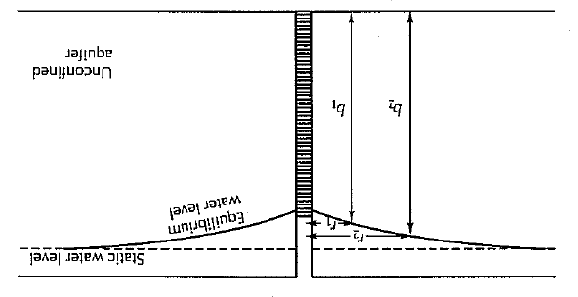
Steady State Unconfined Aquifer (Thiem solution)
H
Q is volume flow rate of well
r1 is radius from pumping well to observation well 1
r2 is radius from pumping well to observation well 2
b1 is head at well 1
b2 is head at well 2
Know how to translate depth to water (d) information into heads
b1= H-d1 b2=H-d2
You need to know depth of aquifer H

Slide 5
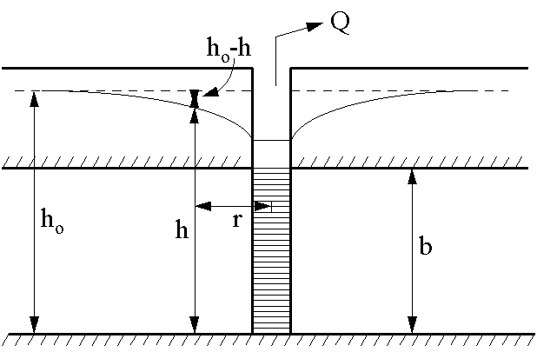
Flow in a Completely Confined Aquifer – Theis’ Solution
Additional Assumptions (Again – know these)
Aquifer is confined on top and bottom
No recharge
Aquifer is compressible and water is released instantaneously
Well is pumped at a constant rate

Slide 6
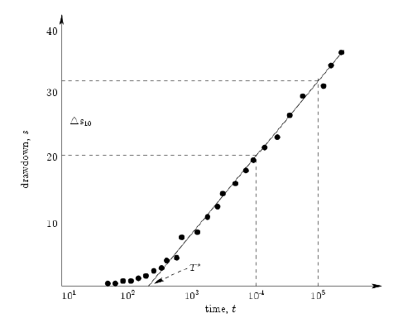
Data from a pumping test
Q is volume flow rate of well
r1 is radius from pumping well to observation well 1
Time when line intersects x axis
Change in drawdown over one decade on log scale

Slide 7
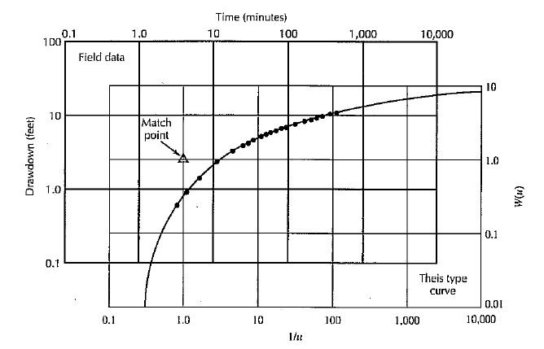
Overlay the Two and pick a match point (does not have to be on the curves – usually 1,1 on well function curve)
Typically we pick match point such that W(u)=1 and u=1
Q is volume flow rate of well
r is radius from pumping well to observation well
h-h0 is drawdown on data at match point
t is time on data plot at the match point

Slide 8
Slug Tests – The Poor Man’s Alternative
Pumping Tests are expensive for many many reasons (labor costs, well drilling costs, equipment, etc.). Sometime one way also not actually wish to extract water from an aquifer for fear that it may be contaminated.
Slug Tests (or their counterpart bail-down tests) are a cheap and quick alternative
A known quantity of water is quickly added or removed from a well and the response of water level in the well is measured.
Water does not have to be added – instead a slug of known volume can be thrown in, displacing a known volume of water.
Slug test responses can be overdamped or underdamped and different and appropriate methods must be chosen to properly analyse data.

Slide 9
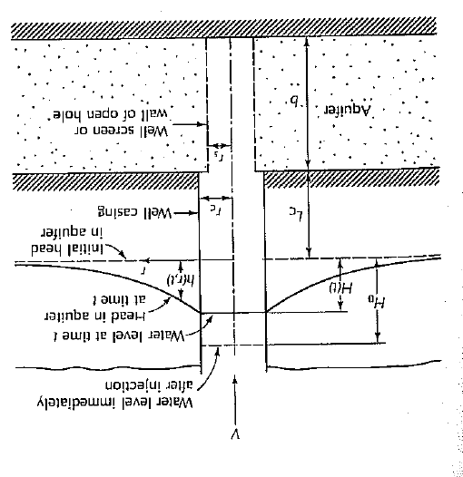
Overdamped Cooper-Bredehoeft-Papadopulos
rc is well casing radiius
rs is well screen radius
corresponds to best match curve (log₁₀ mu=??)
t₁ is the time on real data curve where on the type curve Tt/r_{c}²=1 on best match type curve

Slide 10
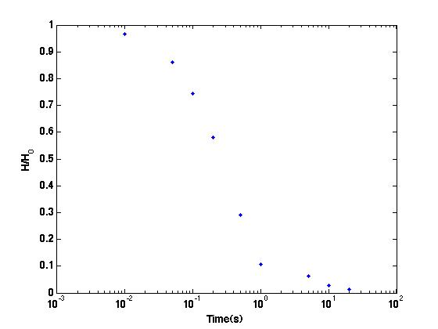
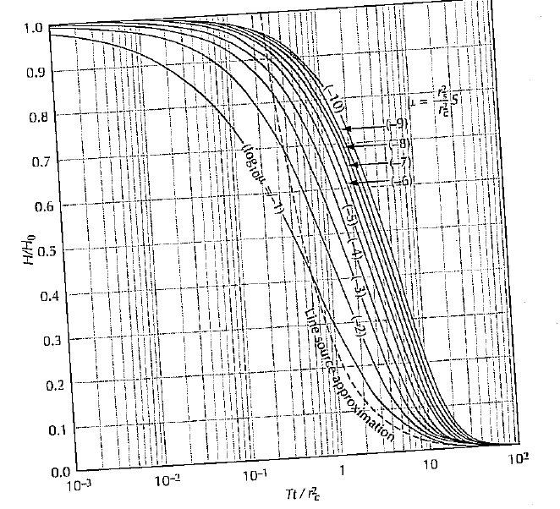
Overlay Graphics

Slide 11
Overlay Graphics
Tt/r_{c}²=1 on type curve plot

Slide 12
Remove the Type Curve, but keep vertical line
When overlaid on Figure 5.19
We identify mu=1e-6 (see figure below)
t₁=0.1
t₁=0.1

Slide 13
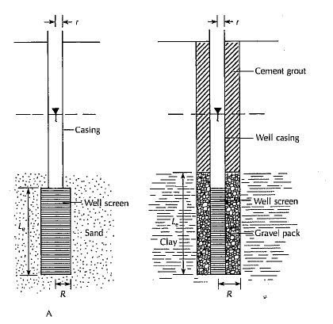
Overdamped Hvorslev Method
If the length of the piezometer is more than 8 times the radius of the well screen, i.e. L_{c}/R>8 then
K – hydraulic conductivity r – radius of the well casing R – radius of the well screen L_{e} – length of the well screen t37 – time it take for the water level to rise or fall to 37% of the initial change.

Slide 14
Overdamped Hvorslev Method Interpretation
If the length of the piezometer is more than 8 times the radius of the well screen, i.e. L_{c}/R>8 then
K – hydraulic conductivity r – radius of the well casing R – radius of the well screen L_{e} – length of the well screen t37 – time it take for the water level to rise or fall to 37% of the initial change.

Slide 15
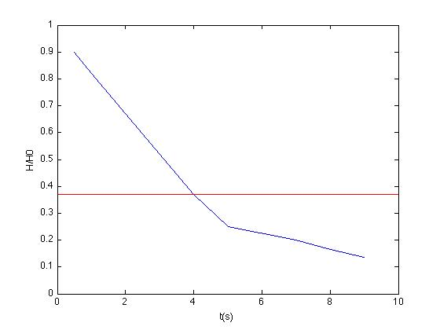

Slide 16
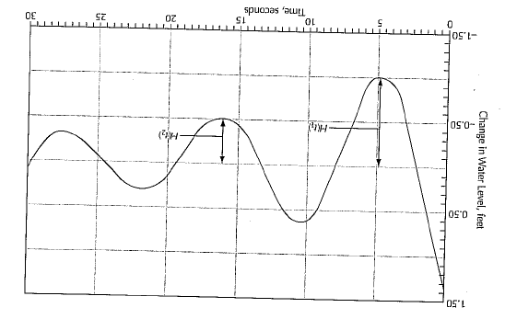
Underdamped Van der Kamp
Then
Until converged

Slide 17
Cautions and Guidelines for Slug Tests (Know these)
Skin Effects can yield underpredictions
Geological Survey Guidelines
Three or more slug tests should be performed on a given well
Two or more different initial displacement should be used
The slug should be introduced as instantaneously as possible
Good data acquisition equipment should be used
An observation well should be employed for storage estimation
Analysis method should be consistent with site
Study results carefully and reassess analysis method if necessary
Appropriate well construction parameters should be used

